Slide 1
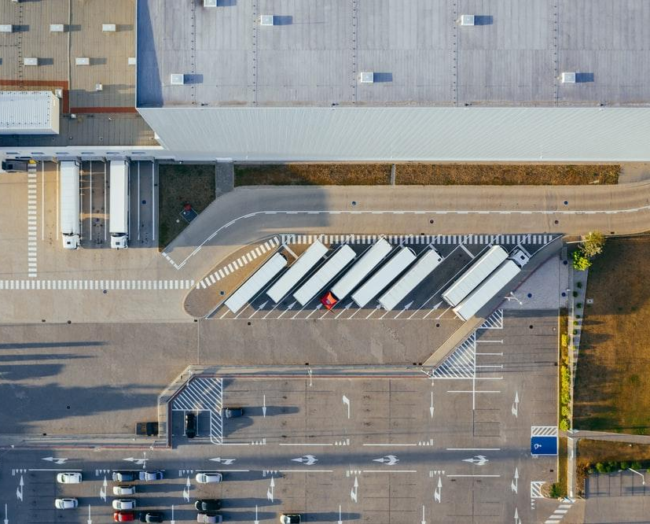
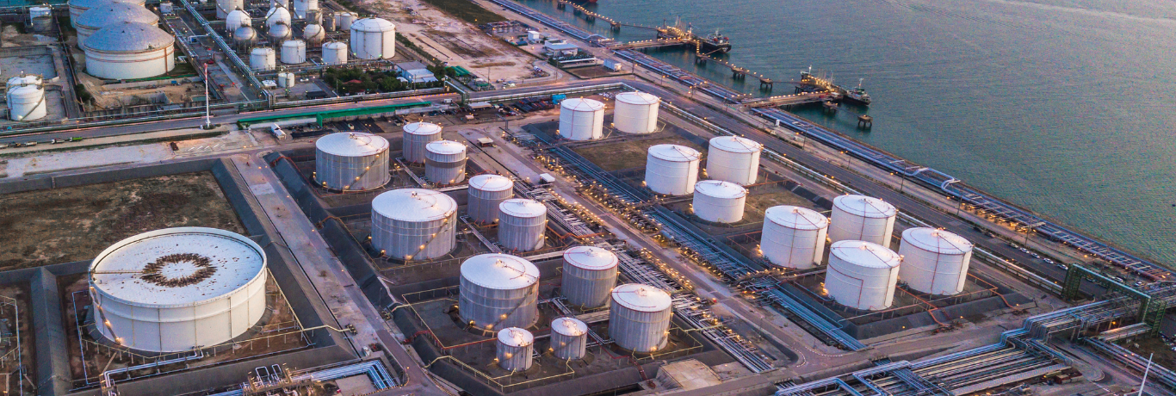



Industrial risks
in Bas-Rhin
Geographical Information Systems
Group 12：Xiaowei SHI Yupeng CHEN
Chaymae DAHHASSI Clémence LEROUGE
Axel BUTTARD

Slide 2
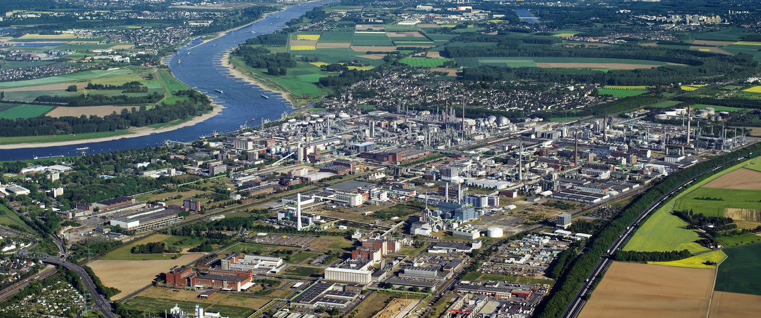
01
Introduction
CONTENT
02
Methology
03
Analysis
Human and social impacts
Environmental impacts:
Pollutions and accidents
04
Solutions
05
05
Conclusion

Slide 3
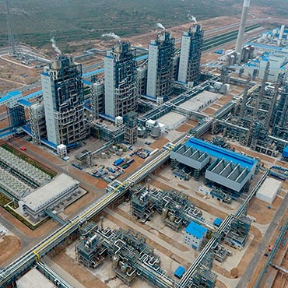

Introduction
01

Slide 4
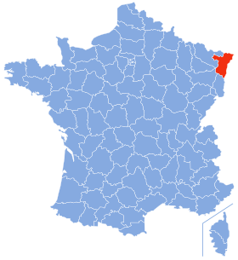
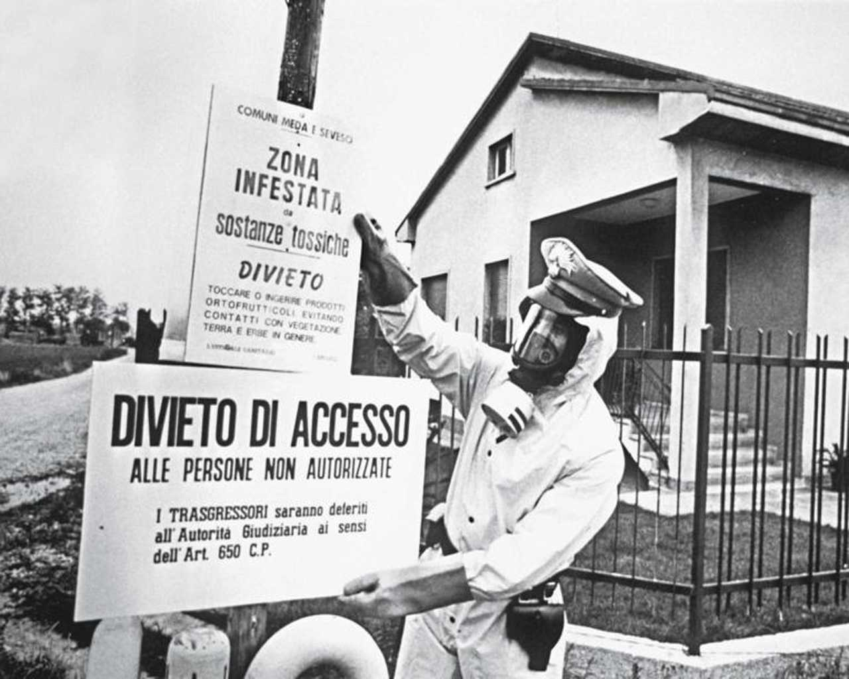
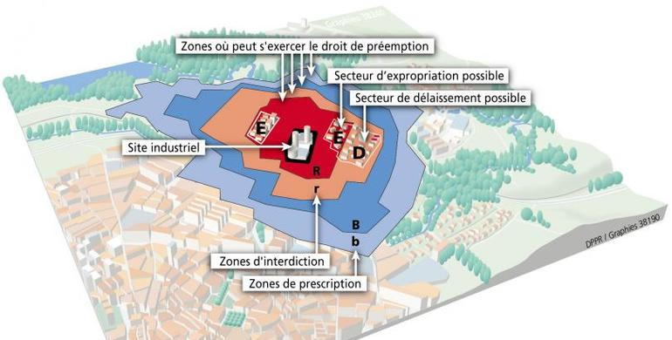
Introduction
Seveso
In Bas-Rhin, there are 22 sites classified as Seveso,
high risk：18 Low risk：4
PPI
Specific Intervention Plan
organize the rescue operations in case of a major accident
Figure1. Geographical situation of Bas-Rhin
Figure2. A Carabinieri in a biohazard suit installs signs warning of the presence of toxic chemicals.
PPRT
Technological Risk Prevention Plan
Construction restrictions ＆Safety measures implementation ＆Public risk awareness
Question
What strategies are implemented to effectively minimize the risks induced by the presence of Seveso-classified sites in the region BasRhin ?
Figure3. Zoning Plan for Technological Risk Prevention around an Industrial Site.

Slide 5
Methology
02

Slide 6

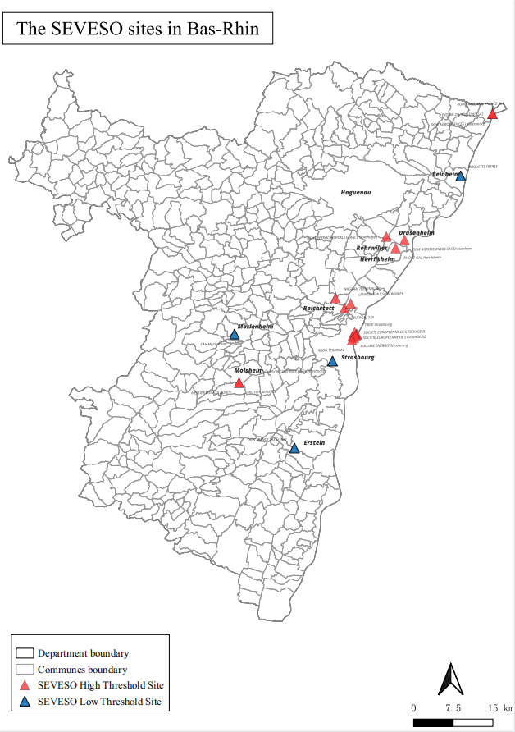
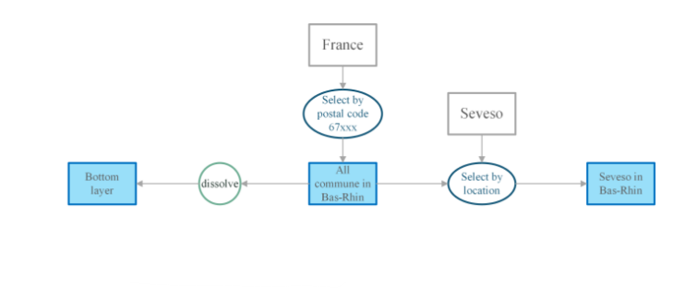
Methology
QGIS
A global map
Specific map for different situation
Figure4. The diagram for global map
Made by group 12
Source: Openstreetmap

Slide 7
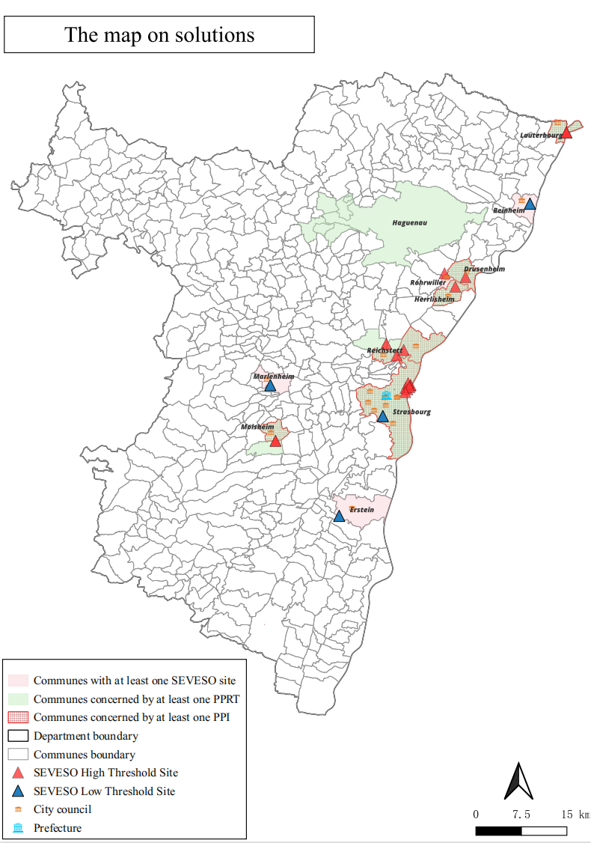
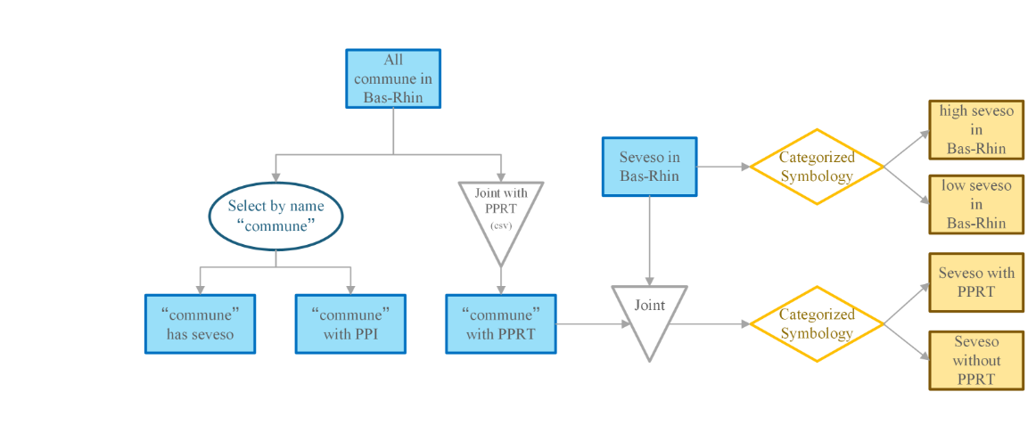
Methology
The map for solution
data
‘commune’with PPRT .csv
the name of commune with PPI in Bas-Rhin
Figure5. The diagram for map
Made by group 12
source: Openstreetmap

Slide 8
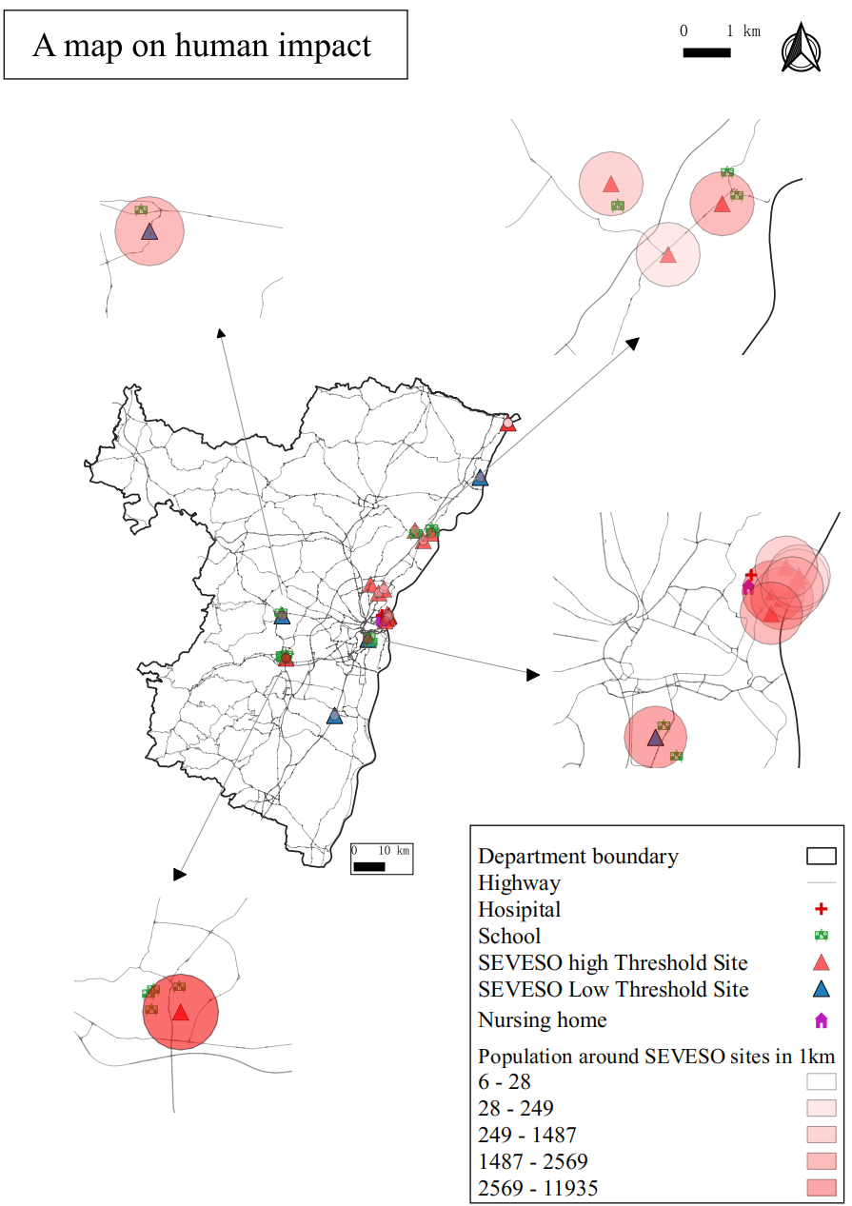
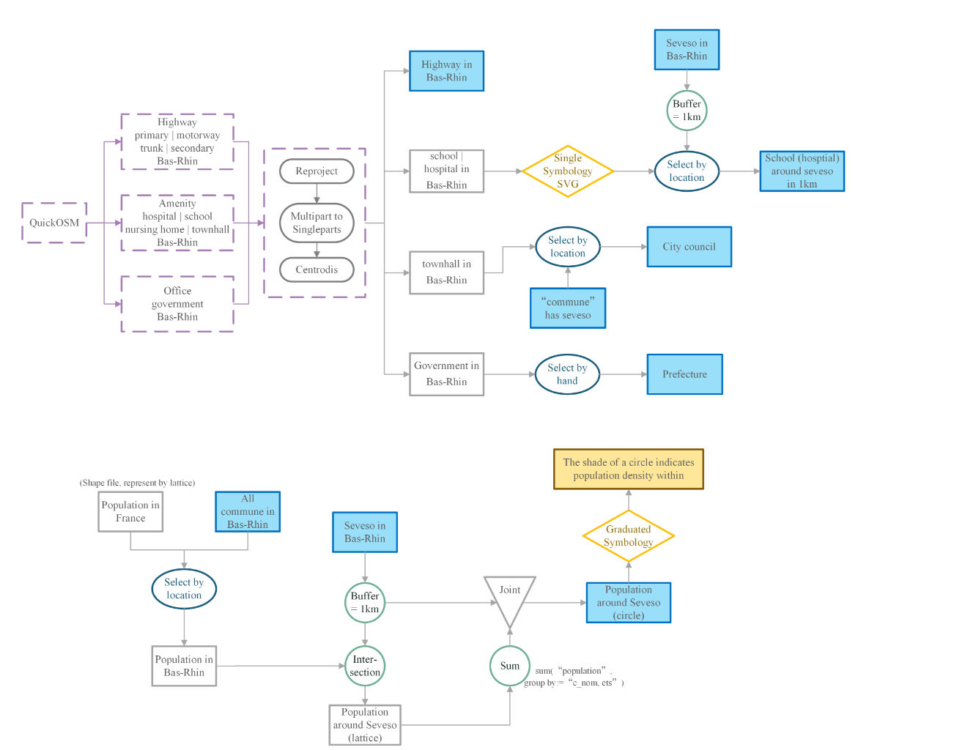
Methology
The map for human impact
Made by group 12
source: INSEE
Figure6. The diagram for the map

Slide 9
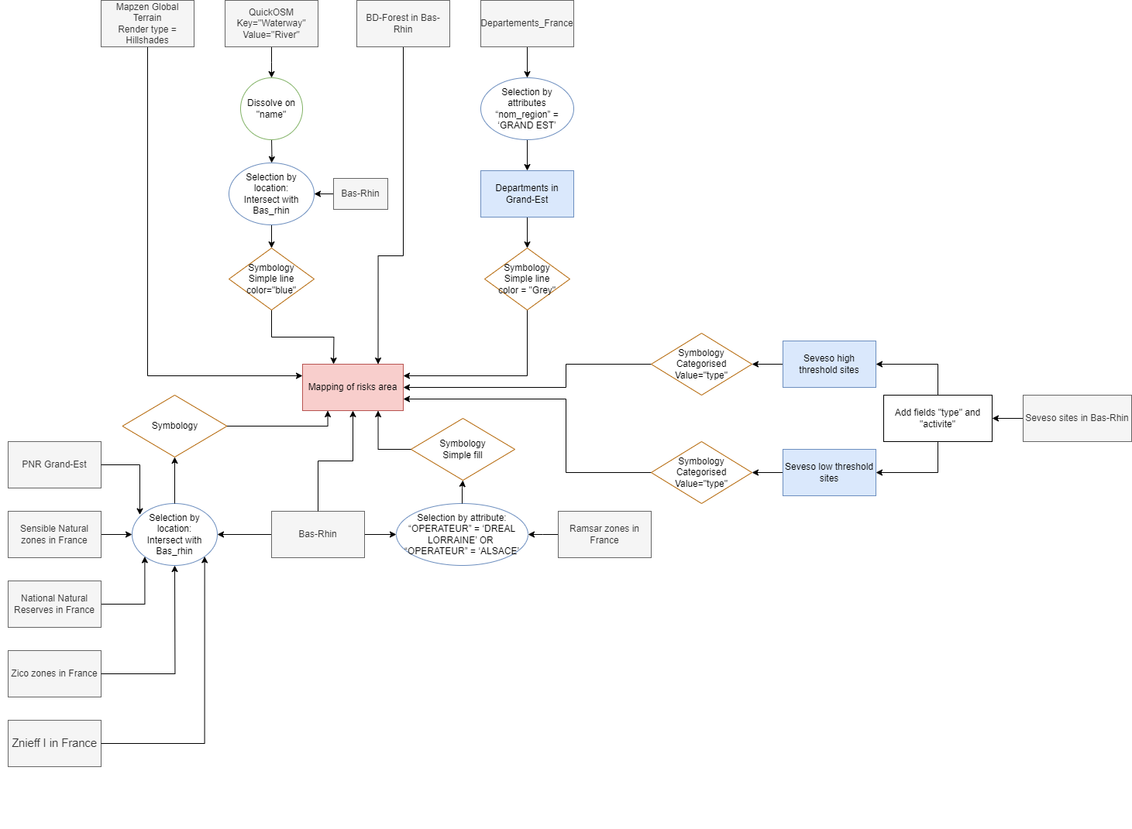
Methology
Environmental aspects
Map
of natural risks area

Slide 10
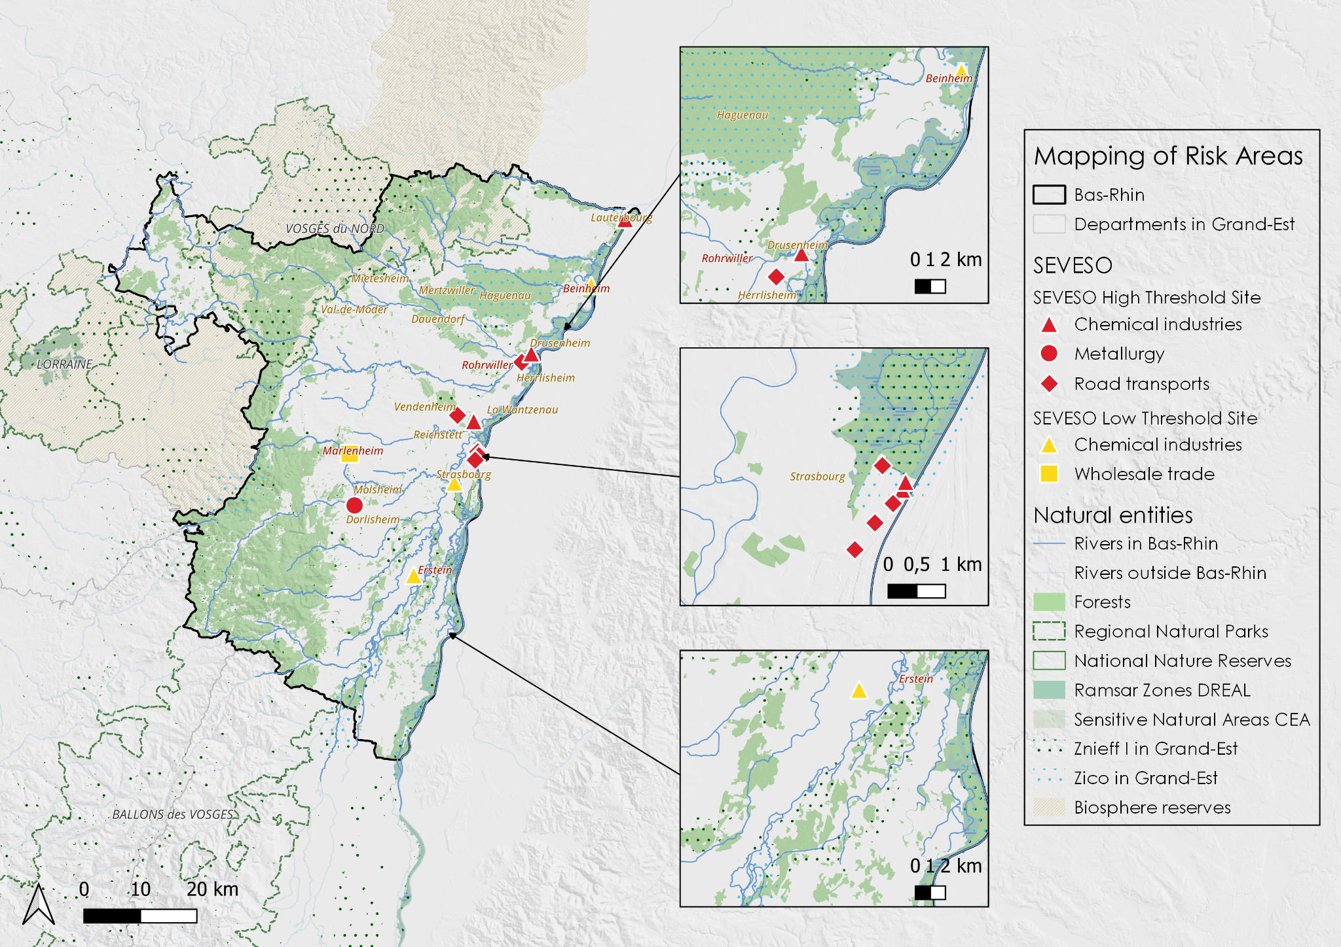
Analysis
Map
of natural
risks area

Slide 11
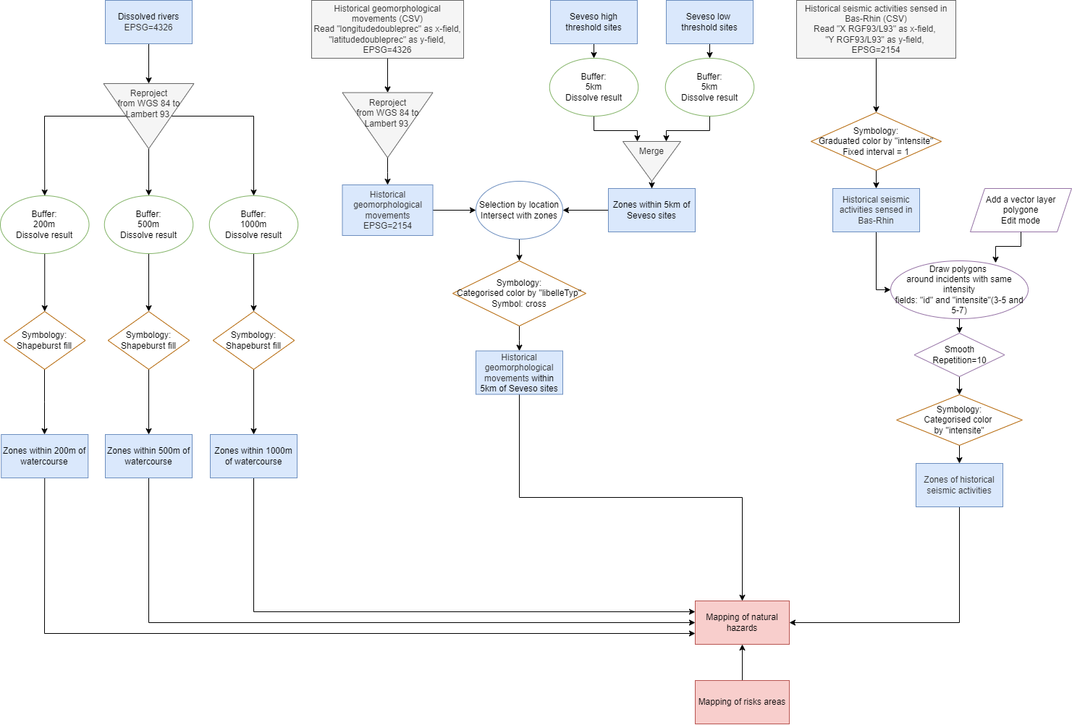
Methology
Environmental aspects
Map
of natural risks area

Slide 12
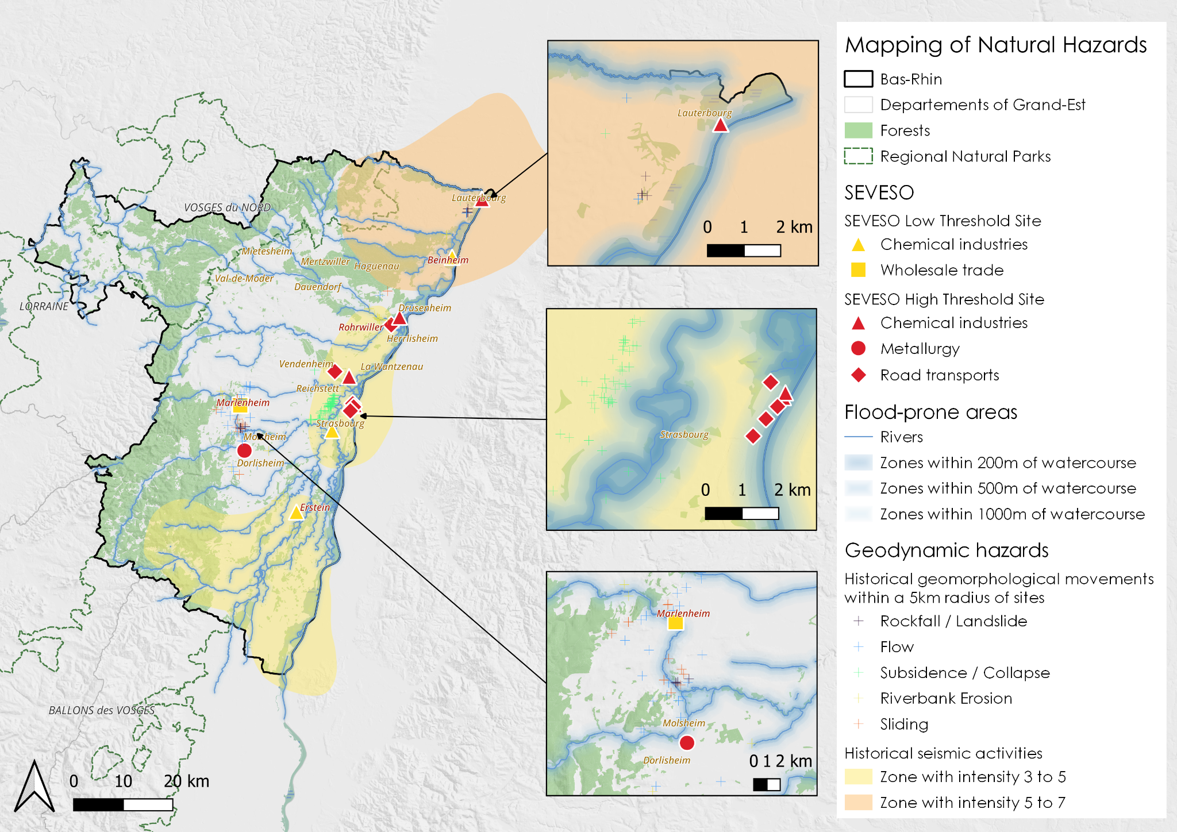
Analysis
Natural
Hazards
map

Slide 13
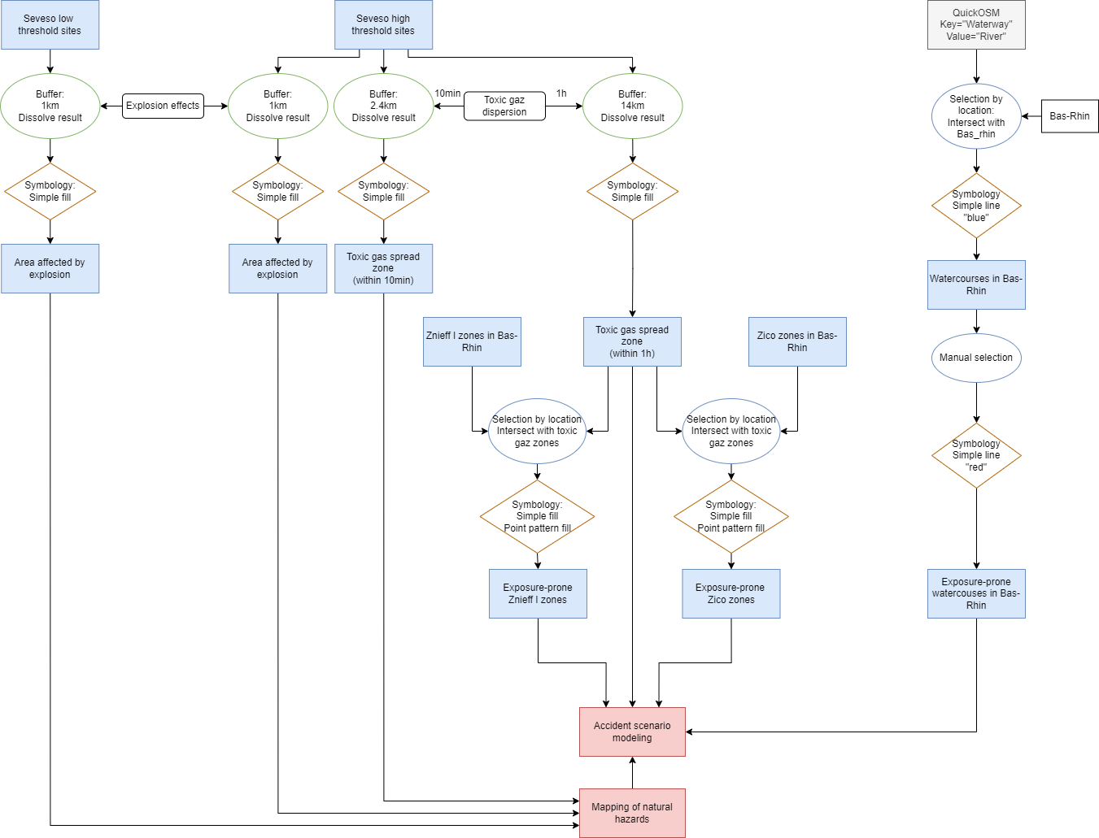
Methology
Accident
scenario
modeling

Slide 14
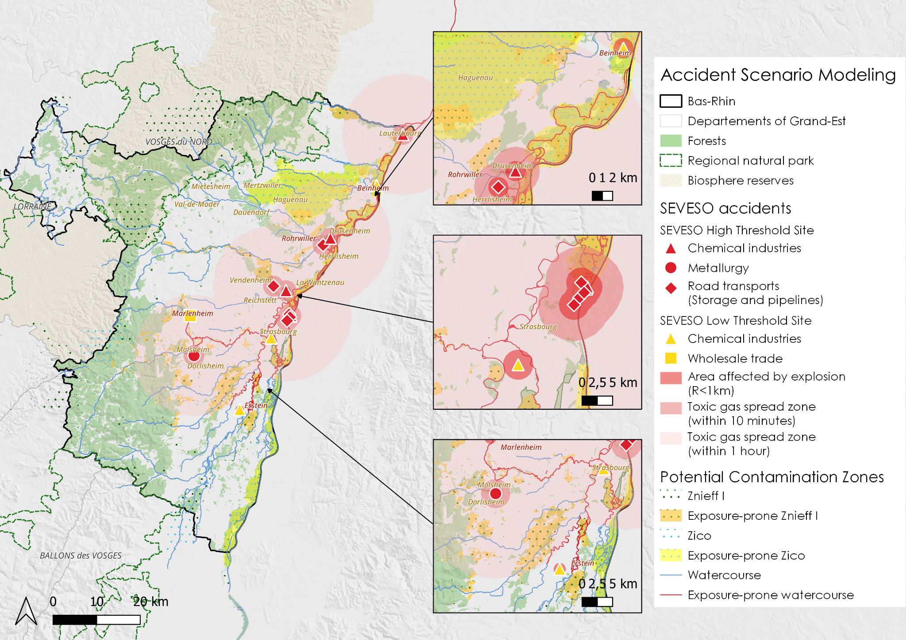
Analysis
Accident
scenario
modeling

Slide 15
Analysis
03

Slide 16
Analysis
Natural
Hazards

Slide 17
Analysis
Human and Social impact
Vulnerable population
Density of population around Seveso sites
Psychological distress
Health effects (Genotoxicity, carcinogenicity, neurotoxicity, immunotoxicity..)
Disruption of vital services
Economic hardship

Slide 18
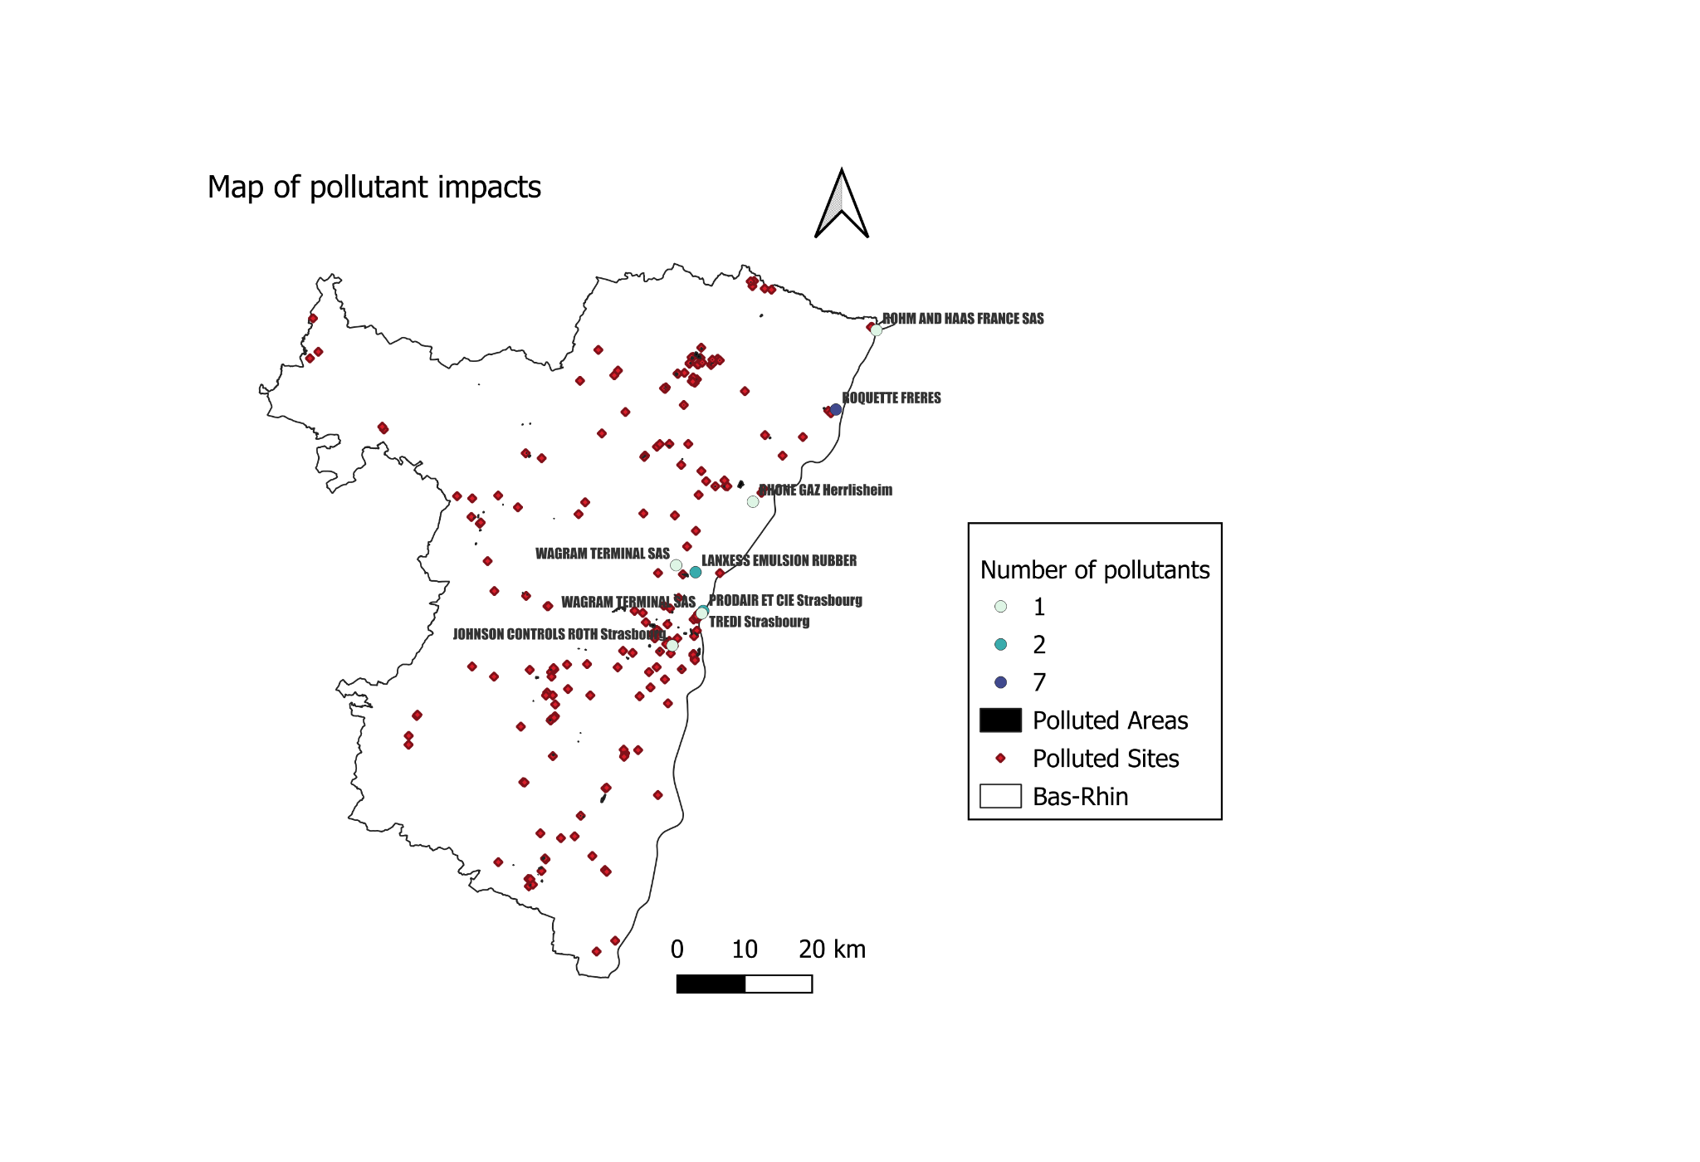
Analysis
Environmental impacts
Pollutant risks
Acid rain
Soil acidification
Soil pollution by heavy metals
Made by group 12

Slide 19
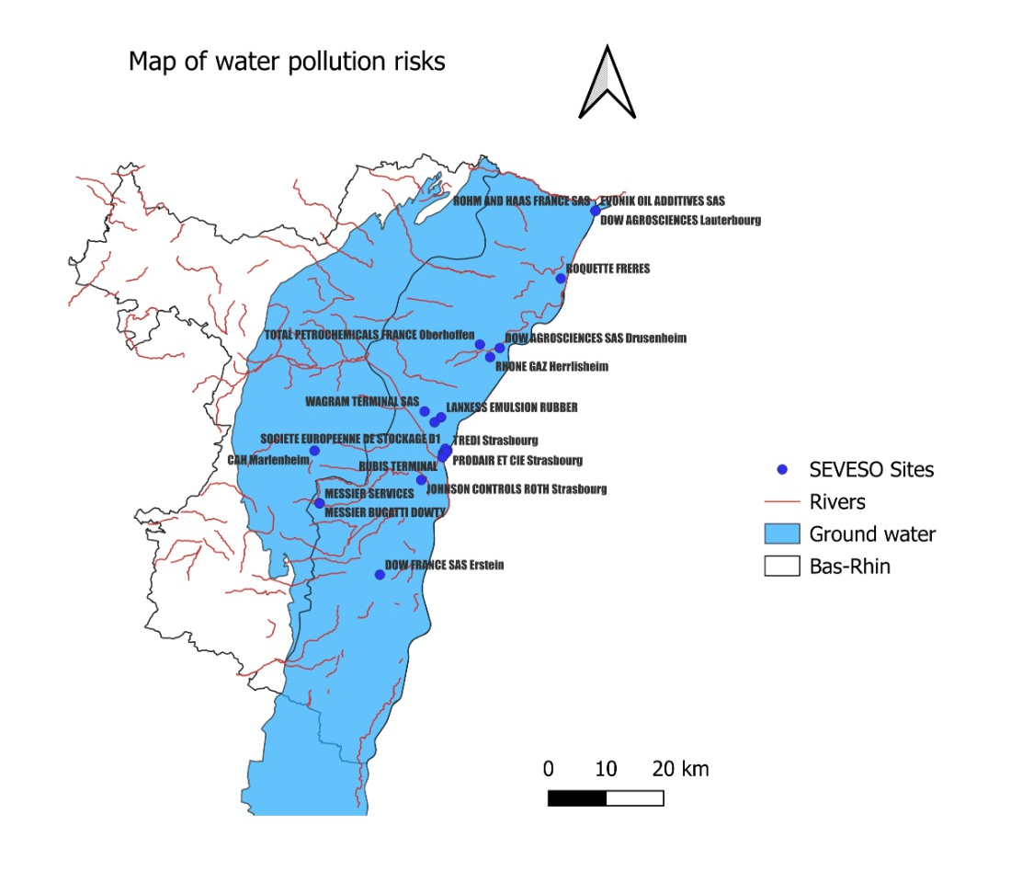
Analysis
Environmental impacts
Water pollution risks
Degradation of water quality
Contamination of surface water and ground water
Disruption of aquatic ecosystems and biodiversity
Damage to vegetation

Slide 20
Analysis
Biodiversity
risks

Slide 21
Analysis
Accident
Scenario
And
Natural
impacts

Slide 22
Solutions
04

Slide 23
SOLUTIONS
Seveso III directive
PPRT (Technological Risk Prevention Plan)
PPI (Specific Intervention Plans)

Slide 24
CLIC (local information and consultation committees)
POI (Internal Emergency Response)
ICPE (Installations classified as environmental protection)
SOLUTIONS

Slide 25
Conclusion
05

Slide 26
Conclusion
What strategies are implemented to effectively minimize the risks induced by the presence of Seveso-classified sites in the region BasRhin ?
Regulatory frameworks established at the national and European levels
Risk Assessment and Management
Emergency Response Protocols
Stakeholder Collaboration
Public Awareness and Education
Continuous Monitoring, evaluation, and Improvement
Limits of our studies and potential improvements

Slide 27
Sources
Sales, J., Wood, M. and Jelínek, R. (n.d.). Risk Mapping of Industrial Hazards in New Member States. [online] Available at: https://publications.jrc.ec.europa.eu/repository/bitstream/JRC38185/jrc38185_saleswoodjelinek.pdf [Accessed 25 Mar. 2024].
‌Les services de l’État dans le Bas-Rhin. (n.d.). Les Plans Particuliers d’Intervention PPI. [online] Available at: https://www.bas-rhin.gouv.fr/Actions-de-l-Etat/Securites-et-prevention/Protection-civile/Risques/Risques-technologiques/Les-Plans-Particuliers-d-Intervention-PPI [Accessed 25 Mar. 2024].
‌4.2. Le risque industriel n 4.2.1. Qu’est-ce que le risque industriel et comment se manifeste-t-il ? (n.d.). Available at: https://www.bas-rhin.gouv.fr/contenu/telechargement/29249/200801/file/Risque+industriel.pdf [Accessed 25 Mar. 2024].
‌Les services de l’État dans le Bas-Rhin. (n.d.). Les Plans de Prévention des Risques Technologiques (PPRT). [online] Available at: https://www.bas-rhin.gouv.fr/Actions-de-l-Etat/Prevention-des-risques-naturels-et-technologiques/Risques-technologiques/Les-PPRT/Les-Plans-de-Prevention-des-Risques-Technologiques-PPRT [Accessed 25 Mar. 2024].

Slide 28
Sources
Géorisques. (n.d.). Dossier expert sur les installations classées. [online] Available at: https://www.georisques.gouv.fr/consulter-les-dossiers-thematiques/installations [Accessed 25 Mar. 2024].
‌Les services de l’État dans le Bas-Rhin. (n.d.). Les Plans Particuliers d’Intervention PPI. [online] Available at: https://www.bas-rhin.gouv.fr/Actions-de-l-Etat/Securites-et-prevention/Protection-civile/Risques/Risques-technologiques/Les-Plans-Particuliers-d-Intervention-PPI [Accessed 25 Mar. 2024].

Slide 29
Thanks for
Your Attention！
Group 12：Xiaowei SHI Yupeng CHEN
Chaymae DAHHASSI Clémence LEROUGE
Axel BUTTARD

